Slide 1
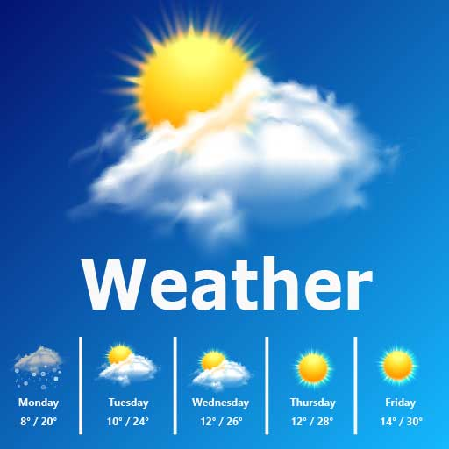
Weather App
A simple web application to fetch real-time weather data

Slide 2
What is the Weather App?
A simple web-based weather application
Users can search for real-time weather updates by city
Provides temperature, wind speed, and a short weather description

Slide 3
Key Features
User-friendly interface
Real-time weather updates
Responsive design
Minimalist UI

Slide 4
Technologies Used
HTML: Structure of the application
CSS: Styling and layout
JavaScript: Fetching and displaying weather data
Weather API (Visual Crossing)

Slide 5
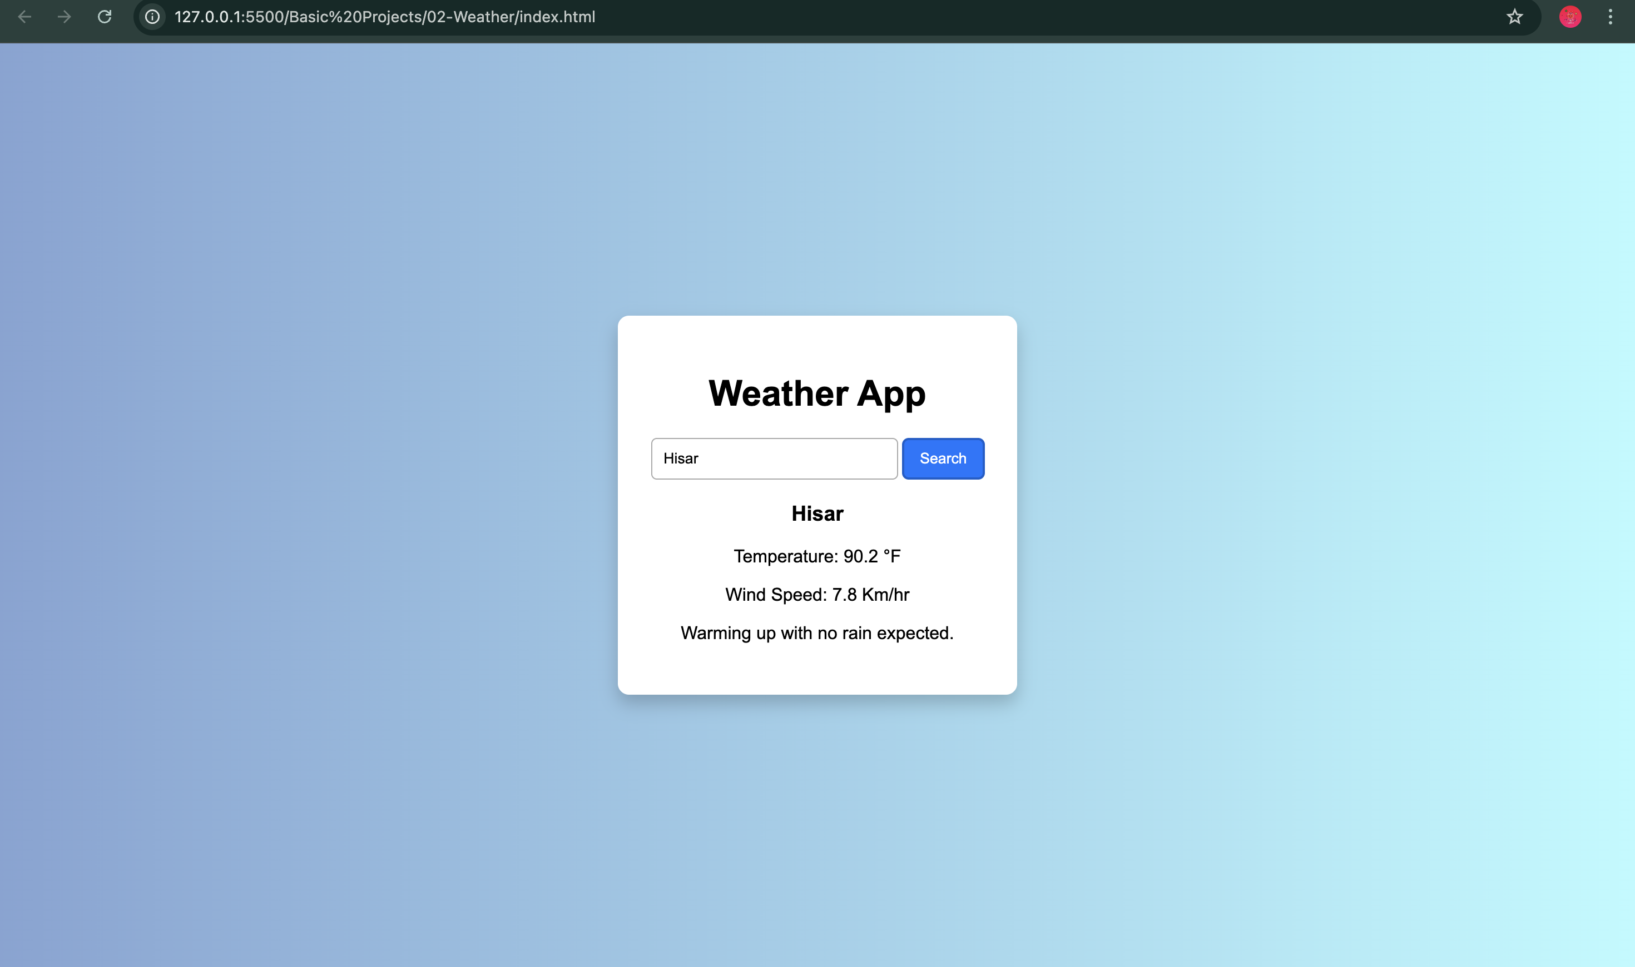
User Interface Preview
Gives Temperature , Wind speed for a given city

Slide 6
How It Works
HTML: Defines the structure
CSS: Enhances the look
JavaScript:
Captures user input
Fetches weather data from API
Displays information dynamically

Slide 7
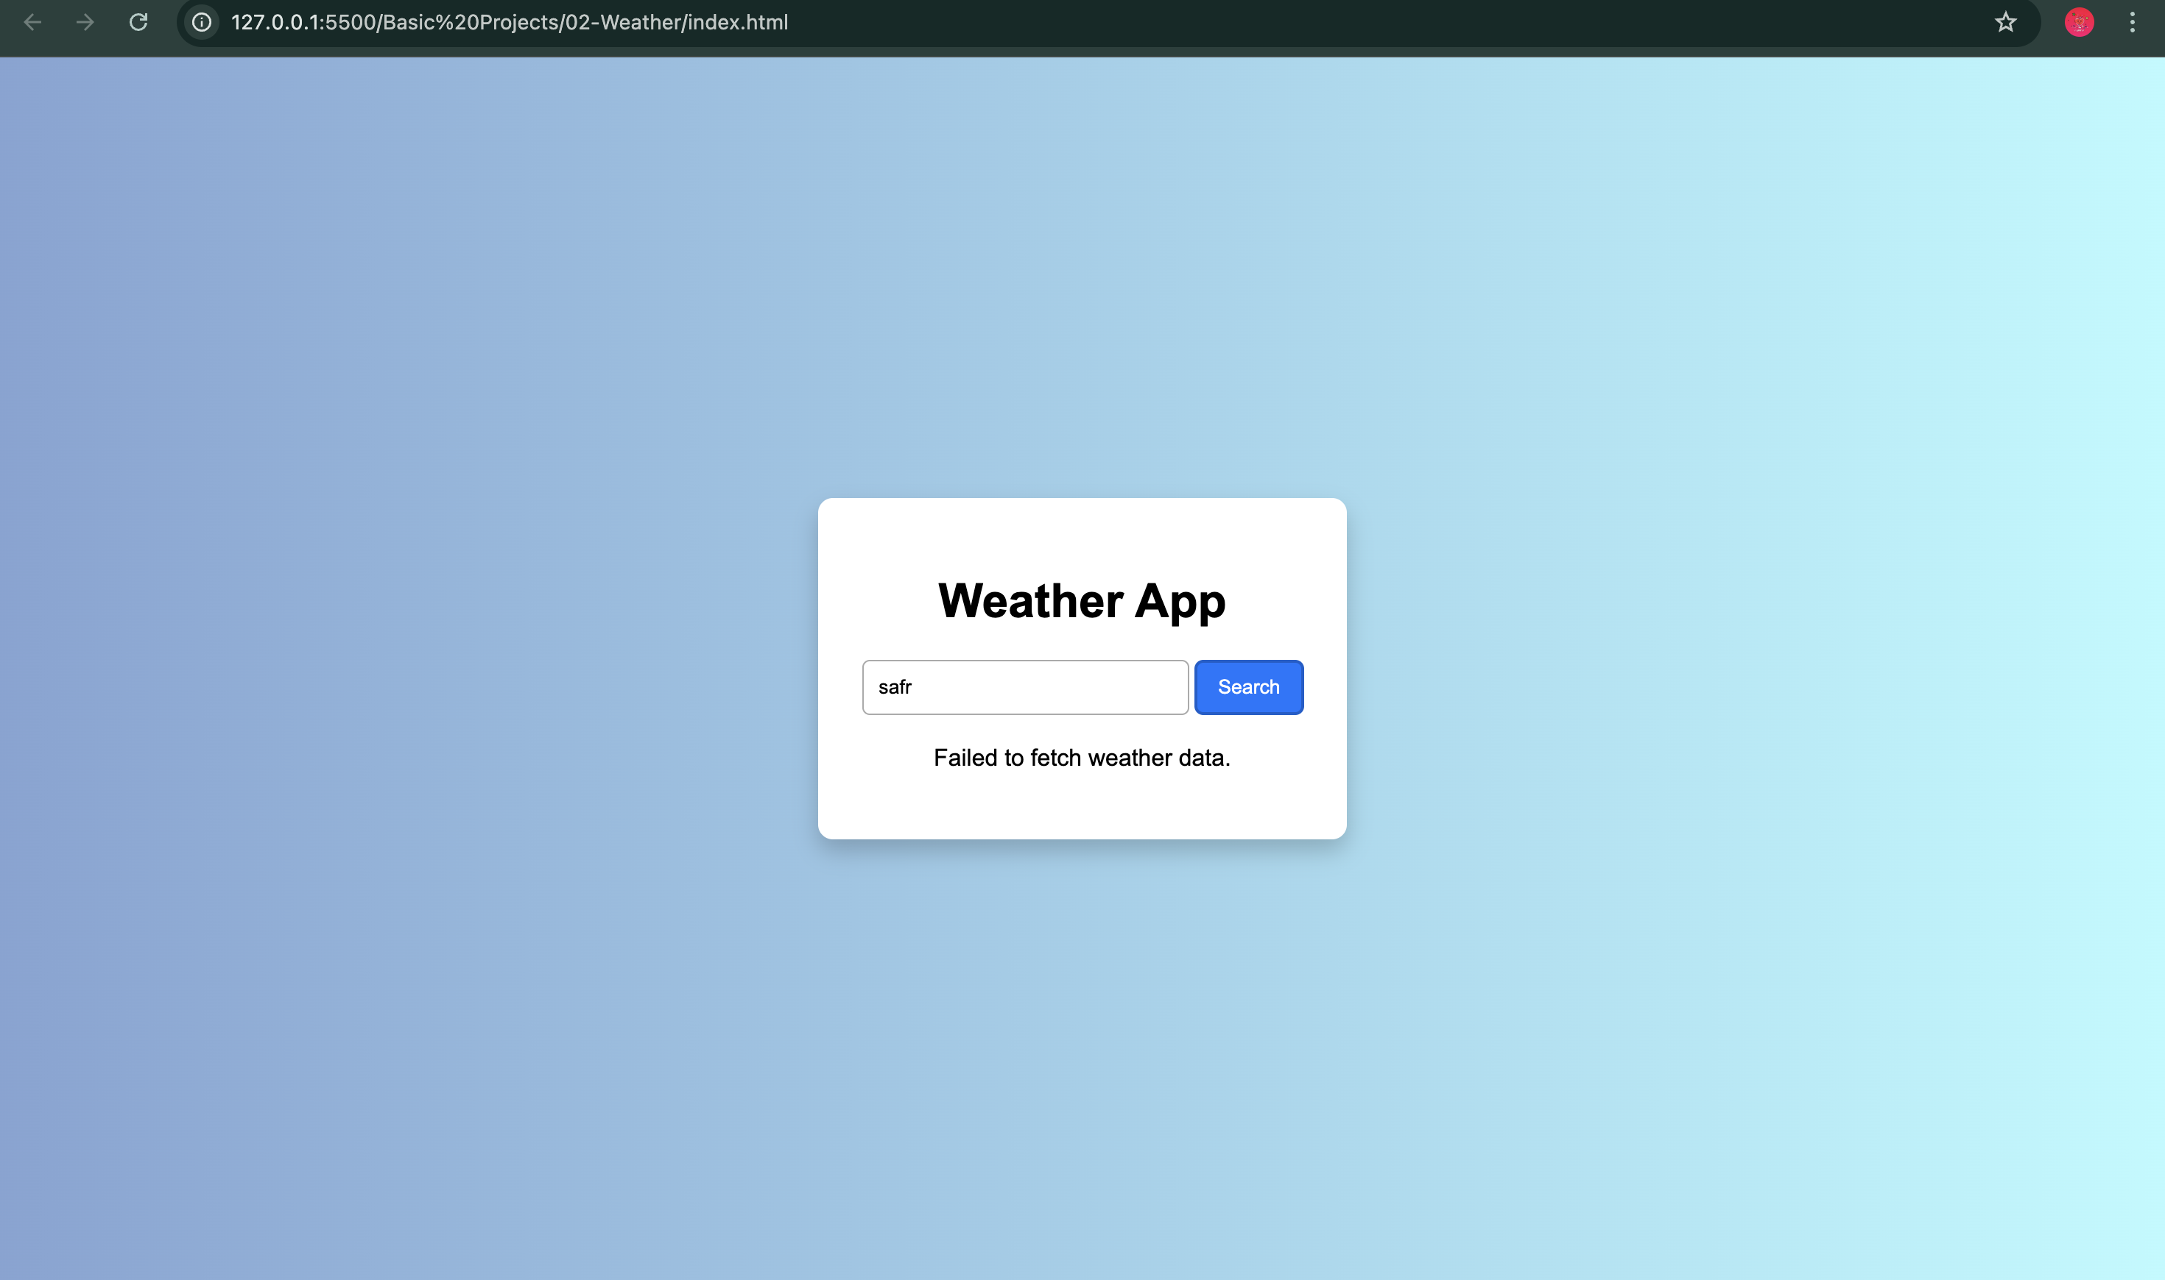
Error Handling
User entered an invalid City

Slide 8
Future Improvements
Add forecast data for upcoming days
Implement geolocation for automatic city detection
Introduce dark mode for better UI experience
Improve error handling for better user feedback

